Slide 1
Intro to IR
Cyber Club

Slide 2
What is an Incident?
Examples: phishing email, ransomware, data leak, social engineering, etc.
Event: Any observable occurrence in a system or network.
Incident: A security event (or series of events) that actually compromises or poses a serious threat to the confidentiality, integrity, or availability (CIA) of information or systems.

Slide 3
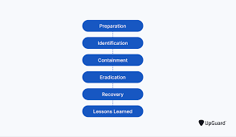
Why Incident Response Matters
Minimizes Damage and Downtime
Reduces Financial Impact
Protects Sensitive Data
Improves Detection and Prevention
Builds Trust and Accountability
Meets Legal and Regulatory Requirements
Enables Fast Recovery and Business Continuity

Slide 4
About NIST & This Framework
NIST stands for the National Institute of Standards and Technology, a U.S. government agency under the Department of Commerce.
NIST develops standards, guidelines, and best practices to help organizations improve their cybersecurity posture.
Publishing special publications (SP) like NIST SP 800-series, which cover security controls, risk management, and incident handling.
SP 800-61r3 provides guidelines for establishing, managing, and improving an organization’s incident response capability.

Slide 5
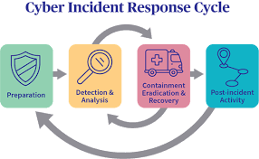
The NIST Incident Response Lifecycle
Overview of the 4 main phases
Preparation
Detection & Analysis
Containment, Eradication, & Recovery
Post-Incident Activity

Slide 6
Phase 1: Preparation
Purpose: Be ready before something happens
Key Activities:
Build an IR team and define roles
Develop communication plans
Conduct training and simulations
Keep software/hardware inventories
Example: Having an “emergency binder” for your network — who to call, what to do

Slide 7
Phase 2: Detection & Analysis
Purpose: Identify potential incidents quickly and accurately
Key Concepts:
Sources of alerts: antivirus, SIEM, user reports
Triage: Determine if it’s real, how severe, and what’s affected
Document everything
Example: How to tell if a strange login is a hacker or an employee on vacation

Slide 8
Phase 3: Containment, Eradication, & Recovery
Purpose: Stop the bleeding, clean up, and get back to normal.
Containment: Isolate affected systems (like quarantining a sick computer).
Eradication: Remove malware, close vulnerabilities.
Recovery: Restore systems safely, monitor for recurrence.
Example: Pulling a compromised laptop off the network while keeping business running.

Slide 9
Phase 4: Post-Incident Activity
Purpose: Learn and improve
Key Steps:
Conduct a “lessons learned” meeting
Update policies, training, and defenses
Celebrate successes — not just blame
Example: After a phishing incident, teach users how to spot future scams

Slide 10
Roles & Responsibilities
Goal: Show that incident response isn’t just for IT
Incident Response Team (IRT): Technical responders
Management: Authorize actions, communicate externally
Legal/HR: Handle compliance and employee issues
Communications/Public Relations: Manage public messaging
Everyone: Report suspicious activity — awareness is key

Slide 11
NIST SP 800-61r3
https://nvlpubs.nist.gov/nistpubs/SpecialPublications/NIST.SP.800-61r3.pdf

Slide 12
Demo
You are part of your organization’s Incident Response Team. Earlier this morning, the SOC detected unusual web traffic coming from a production web server. Initial alerts suggested a possible PHP upload and execution event.
You have been provided with four log files from the affected host:
- access.log — Web server access history
- auth.log — Authentication attempts and logins
- syslog — System events and process activity
- ids.log — Intrusion Detection System alerts

